Slide 1
Apache Impala
BAS Academy

Slide 2
Agenda
About Impala
Impala Metastore
Impala Architecture
Impala Shell
Impala Commands
Hands On

Slide 3
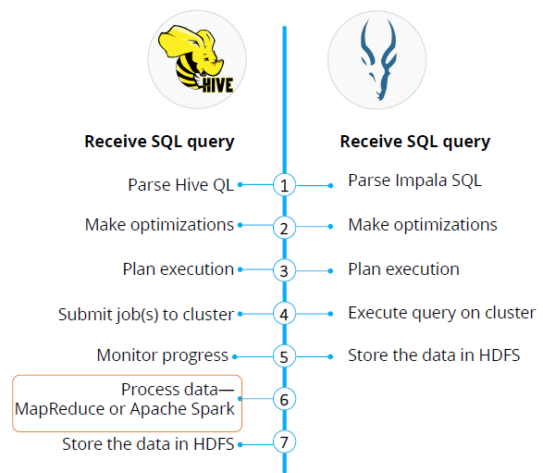
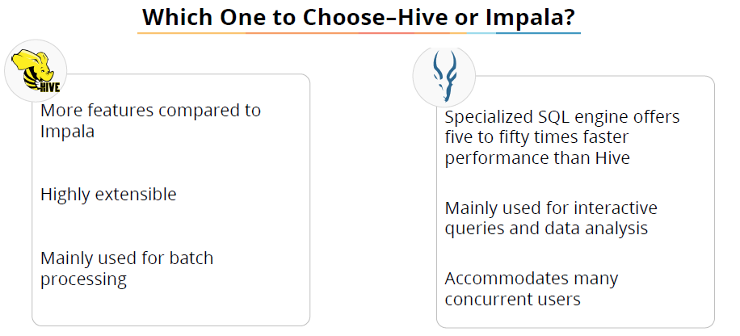
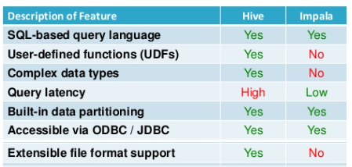
Why Impala
Challenges in MR & Hive:
MR is versatile, flexible and scalable but it has high latency and batch oriented
Hive is built on top of MR, but it is still slow

Slide 4
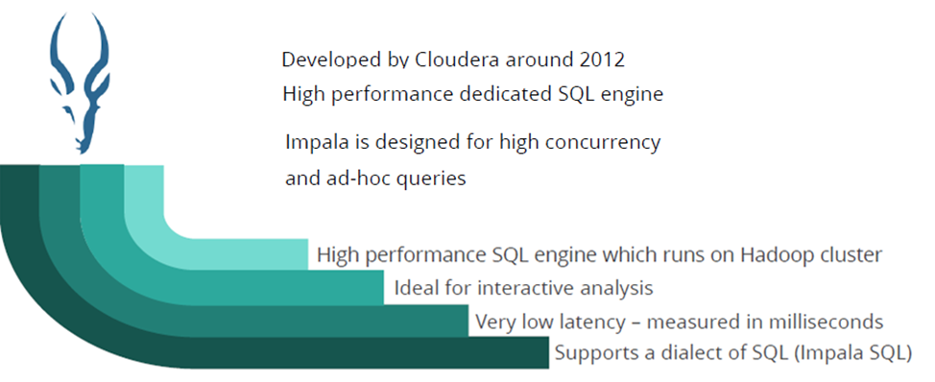
What is Impala
Impala uses same metadata, SQL syntax (Hive SQL), ODBC driver as Apache Hive
Impala supports in memory data processing

Slide 5
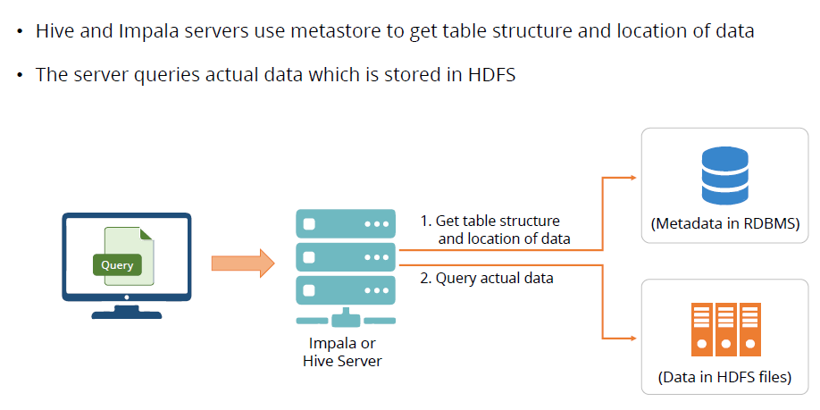
Metastore

Slide 6
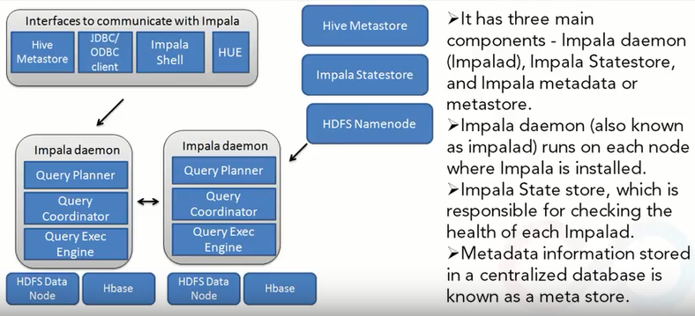
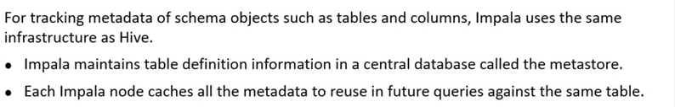
Impala Architecture

Slide 7
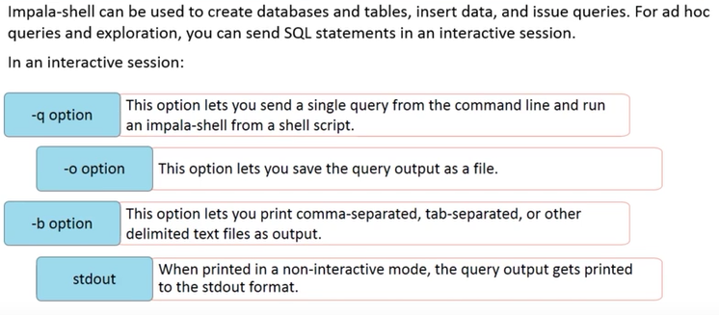
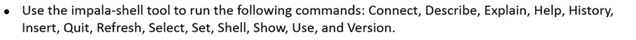
Impala Shell

Slide 8
Impala Commands
Two types of tables can be created in Impala. They are—Managed or Internal table and External table.
The ‘PARTITIONED BY’ clause partitions data files based on one or more specified columns values
Data needs to be loaded by executing the ‘load data inpath’ command
An ALTER TABLE statement is used to change the structure or properties of an existing Impala table such as: rename table, add new column, drop existing column, change column name, replace column data type and add or drop partition
The Drop SQL table statement allows the deletion of an Impala table. On using this statement, the associated data files for the table and the HDFS directory is removed by default. However, if the table is created with the EXTERNAL clause, then Impala does not delete the files and directories
A table metadata, such as column names and data values can be viewed by executing the Describe statement. The ‘DESCRIBE FORMATTED’ variation shows further information

Slide 9
Impala Commands…
Explain Statement returns a plan to execute a statement.
You can see all the tables and views present inside a database by executing the Show Table command.
INSERT statement is used to insert data into tables and partitions. The two types of INSERT statements are as follows: The INSERT INTO syntax appends data to a table. The other INSERT statement that is the INSERT OVERWRITE syntax, replaces the data in the table
The SELECT statement performs queries, retrieves data from tables and produces result sets consisting of rows and columns
In a Select statement, you can use following clauses: JOIN, ORDER BY, GROUP BY, HAVING, LIMIT, UNION
Impala supports several built-in functions. They are: mathematical, type conversion, date and time, conditional, string, and aggregate functions.
The CREATE VIEW statement is used to simplify the complicated queries

Slide 10
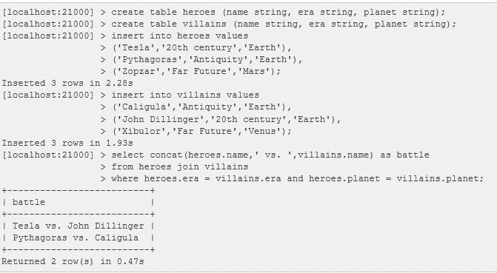
Commands - Example

Slide 11
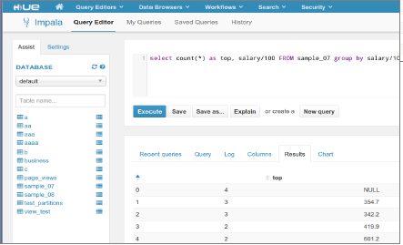
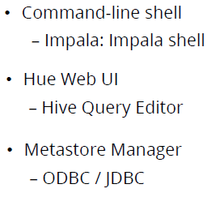
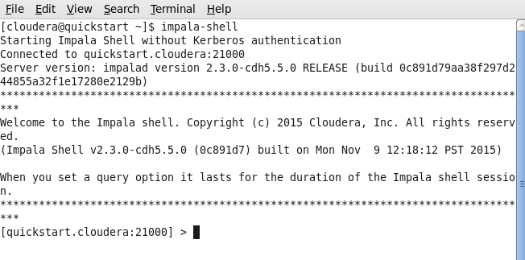
Impala Query Editor

Slide 12
Hands On

Slide 13
Thank You
Keerthiga Barathan

